Slide 1


Today in science…
Rover update
Still waiting for Oppy to wake up!
Impassioned twitter campaign imploring NASA to keep listening began yesterday…
Why?
Funding probably threatened- how long should we listen before declaring Oppy’s mission over?
Notes:
Definitely follow sarcasticrover on twitter.. Really, really funny!

Slide 2

The nature of science and the scientific method

Slide 3
What, how, and why?
What do you think a scientist does?
How do we do science?
Why do we science?
Notes:
Give me two examples!
http://obs.carnegiescience.edu/Magellan

Slide 4
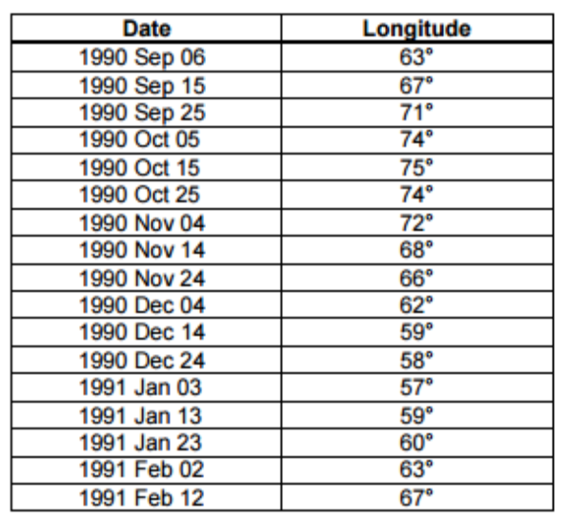
Terminology
Data − properties, generally measured, of processes or phenomena
Example: positions of planets in the sky (properties)
demonstrating their motion (process/phenomenon)
Notes:
Most trivial hill I’m willing to die on: the word ‘data’ is plural (singular, ‘datum’). So while it sounds odd, saying “those data look great” is grammatically correct!

Slide 5
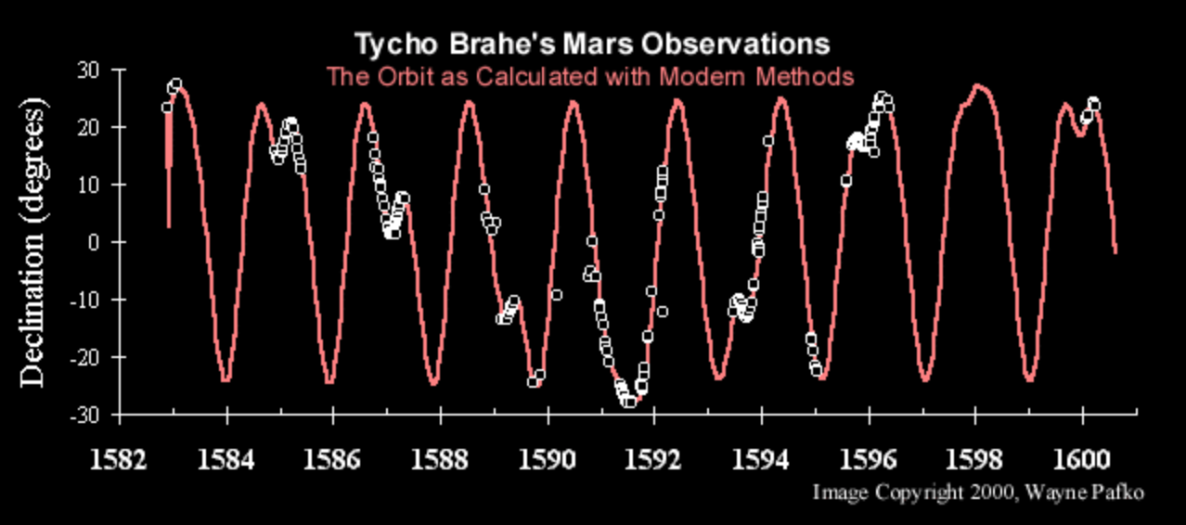
Terminology
Data − properties, generally measured, of processes or phenomena
Observation − data collection without interfering with the phenomenon
Example: Tycho Brahe’s lovely observations
of Mars: all together, a data set.
Notes:
http://www.pafko.com/tycho/observe.html

Slide 6
Terminology
Data − properties, generally measured, of processes or phenomena
Observation − data collection without interfering with the phenomenon
Hypothesis − a question: an initial scientific interpretation of processes or phenomena being observed that needs to be tested to verify
Example: we’ve seen planets move in the sky, and think we understand what Mars is doing. Are all the planets revolving around the Earth?

Slide 7
Terminology
Data − properties, generally measured, of processes or phenomena
Observation − data collection without interfering with the phenomenon
Hypothesis − a question: an initial scientific interpretation of processes or phenomena being observed that needs to be tested to verify
Experiment − a procedure designed to collect data to test the hypothesis; manipulating the phenomenon in a controlled way to better understand it

Slide 8
Experimental astrophysics? Or observational?
Think/pair/share!
By the definitions I just gave for an observation and an experiment, can astrophysicists actually do experiments? Or can we only make observations?
Observation − data collection without interfering with the phenomenon
Experiment − a procedure designed to collect data to test the hypothesis; manipulating the phenomenon in a controlled way to better understand it

Slide 9
Terminology
Data − properties, generally measured, of processes or phenomena
Observation − data collection without interfering with the phenomenon
Hypothesis − a question: an initial scientific interpretation of processes or phenomena being observed that needs to be tested to verify
Experiment − a procedure designed to collect data to test the hypothesis; could include manipulating the phenomenon in a controlled way to better understand it
Example: to test whether all planets are moving like Mars, gather more data to directly compare
Notes:
So let’s update that to *could include* manipulating the phenomenon in a controlled way to better understand it
For astronomers, looking at large samples of stars or planets is in itself a kind of experiment: I can’t make one star hotter to see how it changes, but I can look at a hotter star and compare it to a cooler star

Slide 10
Terminology
Data − properties, generally measured, of processes or phenomena
Observation − data collection without interfering with the phenomenon
Hypothesis − a question: an initial scientific interpretation of processes or phenomena being observed that needs to be tested to verify
Experiment − a procedure designed to collect data to test the hypothesis; could include manipulating the phenomenon in a controlled way to better understand it
Model − a simplified version of reality developed to explain observations
Example: epicycles to explain Mars’ retrograde motion in the sky

Slide 11
Terminology
Data − properties, generally measured, of processes or phenomena
Observation − data collection without interfering with the phenomenon
Hypothesis − a question: an initial scientific interpretation of processes or phenomena being observed that needs to be tested to verify
Experiment − a procedure designed to collect data to test the hypothesis; could include manipulating the phenomenon in a controlled way to better understand it
Model − a simplified version of reality developed to explain observations
Law − a general rule to which many sets of data conform
Theory − an in-depth scientific interpretation of a phenomenon, or a whole group of phenomena, that is capable of making correct predictions
Notes:
While a law sounds better than a theory, it’s not necessarily. Theories are more robust developments of ideas, while laws can be a single equation that describe a lot of data well.

Slide 12
Science!
Science…
Seeks explanations for observed phenomena that rely on natural causes
Progresses through creation and testing models of nature that explain observations as simply as possible
A scientific model must make testable predictions. If the predictions do not agree with the observations, the model must be revised! That’s science.
What do scientists argue about?
Usually, whether the experiment
Was the right approach to answer the question being asked
Included all possible variables that could have impacted the outcome
Or, whether the question asked from the beginning was the right one to be asking
Notes:
If this is all so clear-cut and objective, then what do scientists even argue about?
Sometimes, multiple interpretations can fit the same data set
Other times, there are disagreements on the question being asked, the way it is asked, the setup of an experiment– whether it answers the questions being asked, or if something has been neglected that should not have been.

Slide 13
The scientific method
The scientific method is an approach, a framework for asking and trying to answer questions, for better understanding the Universe
The major steps of the scientific method:
Observe and wonder
Formulate the hypothesis
Observe more, conduct tests, experiment
Interpret the data and results
Was your hypothesis correct? Good! Keep testing to be sure it always does that, to see how far it applies
Results reject hypothesis? Reform, create and test new hypothesis
Unclear? Keep observing, testing, and questioning!
Notes:
The more you know, the more you know you don’t know.

Slide 14
Things we know, and things we know we know
Science is a living body of information
Knowledge that originates from observations, formulation of models to explain observations, and testing to see if models are correct
We believe in science because of rigor: we test and retest, gather more information, and rule out reasonable possibilities
“Common sense” is not a valid argument
There are things we know without having subjected them to rigorous, scientific testing. That’s ok: intuition often even motivates and helps science, but should not be used in its place as justification

Slide 15

Validity of a Scientific Theory
It’s valid until… it’s not!
Newton suggested his law of gravitation in the 1660’s
All possible experiments showed that it was correct until the end of the 19th century. Until…
The precession of the perihelion of Mercury was discovered, and until it was realized that
Newtonian models predict only half of the light deflection by gravity
Einstein’s theory of relativity showed we hadn’t learned everything yet about gravity’s effects!
Notes:
That’s just science. You can come up with an idea that’s amazing and works on almost all the data, but not all of it. We’ve all been to have that heaping helping of humble pie, it’s part of the job.
This is not an advertisement (though it is in Raleigh, and ooh- brunch!)

Slide 16
Making sense of the universe
The Cosmic Perspective, Chapter 4
Notes:
The next two lectures will be about the fundamental forces we use to understand the world around us and the universe
https://apod.nasa.gov/apod/ap151209.html

Slide 17
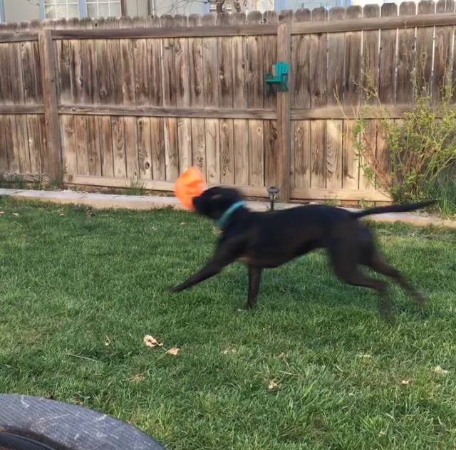
Understanding motion
Consider this mutt. How might we describe her and her blurry motion?
Where she is
x,y,z position in the yard
How fast she’s going
Her speed
Which way she’s going
direction
If she’s slowing down or speeding up
Acceleration or deceleration
Notes:
What we’ll be covering in this chapter…
We do these kinds of calculations, watching, guessing, extrapolating, every single day. When you drive, you have a feel for where someone might go or when you’ll be able to make your turn just based on a few observations, a few data points, in your head. Let’s put some words to those data you take automatically

Slide 18
Speed, velocity, and acceleration
Say you’re in the car.
You have some distance to travel
In some amount of time
Your (average) speed is how far you travel in that time
Units: familiarly, mph or mi/hour
Metric: m/s
Notes:
18

Slide 19
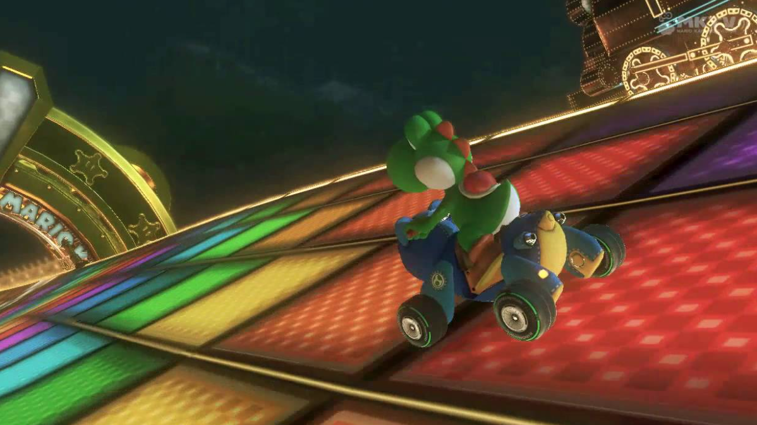
Speed, velocity, and acceleration
Velocity tells you both your speed and direction
Most of Yoshi’s speed is in the forward direction, but he’s steering a little to the left, too, for upcoming turn
What you don’t want in this level is any speed downward…
Velocity also has units of m/s, is usually denoted v

Slide 20
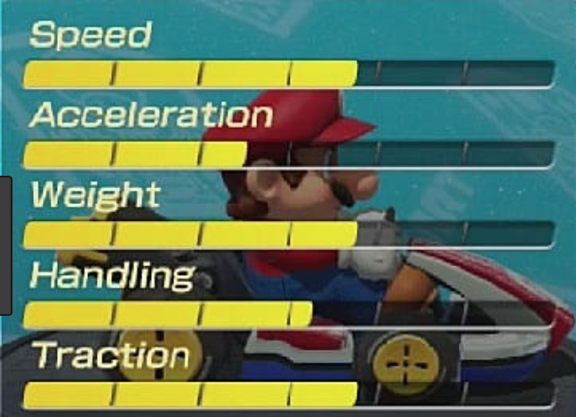
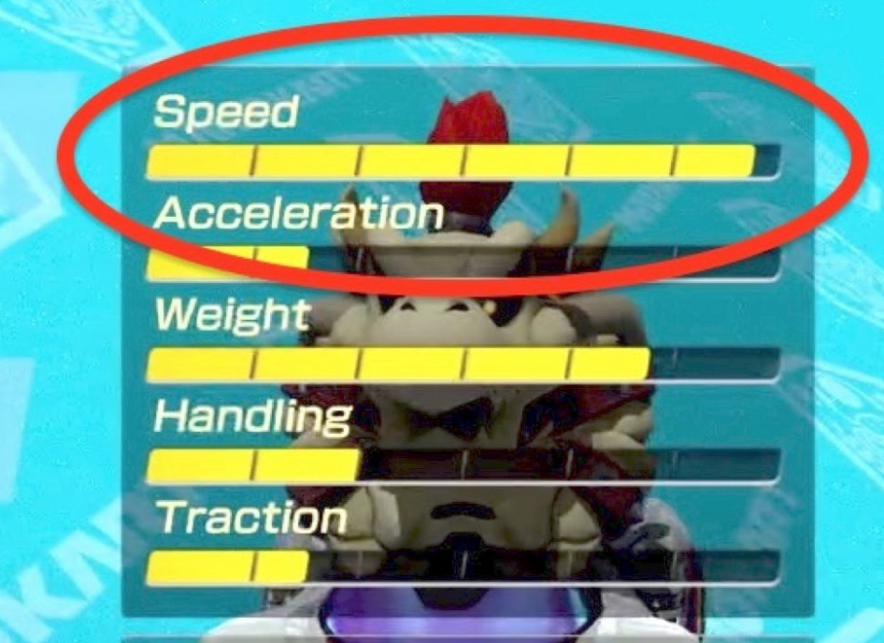
Speed, velocity, and acceleration
Acceleration, denoted a, is a change in velocity over time
Units: Velocity change/time = (m/s) / s = m/s²
To accelerate, your speed, or direction, or both can change
Acceleration can be negative (deceleration)
v_{f} − v_{i}
a = ⎯⎯⎯
t
v_{i} − initial speed
v_{f} − final speed
t − time interval
Notes:
20
Dry Bowser is fast, but ouch- once he hits something… huuuuge deceleration penalty

Slide 21
Acceleration due to gravity
According to legend, Galileo dropped weights from atop leaning tower of Pisa
Objects fall at the same rate, regardless their mass: they experience the same acceleration
Acceleration due to gravity on Earth will increase an object’s speed by 9.8 m/s for every second the object is falling
Denoted as lower-case g
g = 9.8m/s²
Notes:
(corrected units on g)

Slide 22
Momentum and force
Momentum is the product of an object’s mass and velocity, denoted p
p = mv
Two objects of very different mass can have the same momentum if their velocities are different
In same direction as object’s velocity

Slide 23
Momentum and force
Mario’s kart has a decent top speed
Acceleration is ok; important for starting off the line and recovering from impacts
Mario+Kart weight is a little high
Traction and handling are good; it’ll help him where other karts may lose the best line through the corners
Top speed and high weight = more momentum!
If hit by kart with less momentum, will experience less deceleration than other kart
Good acceleration = if hit, can recover from abrupt deceleration more quickly

Slide 24
Momentum and force
Momentum is the product of an object’s mass and velocity, denoted p
p = mv
Two objects of very different mass can have the same momentum if their velocities are different
In same direction as object’s velocity
Force, applied for some amount of time, can change an object’s momentum if the force is great enough
Consider Mariokart: if you’re Yoshi, why don’t you want to be hit on the track by Donkey Kong or Bowser?
The net force on an object is the sum of all the forces acting on an object
Forces are vectors and have directions
You can be experiencing forces in opposite directions yet the net force can be 0
Notes:
Ok, this has been momentum and force along straight lines.. How is this relevant to astronomy? Next up… orbits

Slide 25
Momentum in orbits
Momentum when moving along a curved path: angular momentum
Angular momentum due to rotation: rotational angular momentum
Due to path in an orbit: orbital angular momentum
Notes:
http://www.schoolphysics.co.uk/age16-19/Mechanics/Rotation%20of%20rigid%20bodies/text/Angular_momentum_and_keplers_laws/index.html

Slide 26
Momentum in orbits
Momentum when moving along a curved path: angular momentum
Angular momentum due to rotation: rotational angular momentum
Due to path in an orbit: orbital angular momentum
Angular momentum can also be changed by applying a force- that force is called torque
in cars (or, Mariokarts), torque is used to describe how the car’s engine and drive train can change the angular momentum of the wheels against the ground
how effective an applied torque is depends on how far from the rotation axis it’s applied

Slide 27
Mass vs weight
Mass is a fundamental measure of the amount of matter in an object
Mass is measured with a balance
Unit of mass: g (in US system, our unit of mass is called a slug)
Weight is the downward force exerted by an object of a particular mass under acceleration due to gravity
Weight is measured with a scale
Unit of weight: newtons (lbs, in our daily lives)

Slide 28
Free-fall and weightlessness
Free fall happens when there is nothing to *prevent* you from falling- no force acting against your downward motion
Good example: you go sky diving, voluntarily, because you wanted to*
Scary example from the book: you’re in an elevator and the cable snaps*
*note: there isn’t an absence of forces when you’re skydiving.. Air resistance is a big one, but it’s not stopping you from falling, just slowing you down a little
*note: elevators are really really safe and this basically never happens
Notes:
*

Slide 29
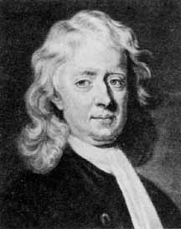
Sir Isaac Newton (1642-1727)
Newton graduated college and left Cambridge about when the plague hit
Sitting around one day, he had a realization that shattered a thousand years of thought or so
Aristotle believed laws governing motion on Earth were distinct and different from those governing motion of stars, planets
United view of Earth and heavens into one Universe; beginning of modern astrophysics
Notes:
29

Slide 30
Newton’s Laws of Motion
In the absence of a net force, an object in motion or at rest remains in motion or at rest
This probably seems somewhat obvious: a parked car on a flat surface isn’t going to just roll away
Notes:
30
Unless the parking brake is off, it’s in neutral, and someone pushes it

Slide 31
Newton’s Laws of Motion
In the absence of a net force, an object in motion or at rest remains in motion or at rest
Force = mass × acceleration (F = ma)
Possibly the most profound of all three laws; what it is saying is that force is the rate of change of momentum.
Notes:
31
Recall that acceleration is the change in the velocity per unit time- if you regroup the terms in the equation, you get a change in momentum per time; that’s what force is

Slide 32
Newton’s Laws of Motion
In the absence of a net force, an object in motion or at rest remains in motion or at rest
Force = mass × acceleration (F = m × a)
For any action (applied force) there is an equal and opposite reaction (force)
Notes:
32
Recall that acceleration is the change in the velocity per unit time- if you regroup the terms in the equation, you get a change in momentum per time; that’s what force is

Slide 33
There’s a video coming after logistical notes, don’t pack up yet

Slide 34
Logistical notes
Check your clicker quiz grades on Canvas- I may have left you a note if you only answered 1/3 or 2/3 of the questions! Was your Clicker malfunctioning?
No office hours today, apologies!
Lab 1 due today at 11:59pm
Median completion time: 30 minutes!
If Stellarium isn’t working: 2 computers in Physics Library with program
There is a web version, but it doesn’t automatically play in time, you have to set date/time
https://stellarium-web.org/#/
Chapter 2 homework due 9/1

Slide 35
To conclude!
A video!
Notes:
https://www.youtube.com/watch?v=D6_UVBAfdHA&frags=pl%2Cwn
Stop at the 8 minute mark

